Slide 1



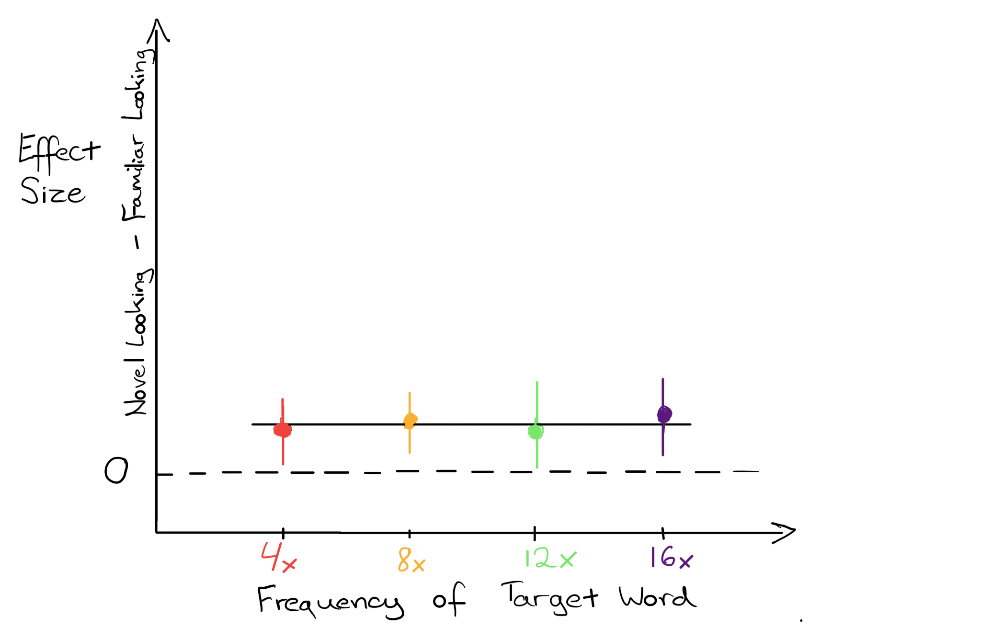
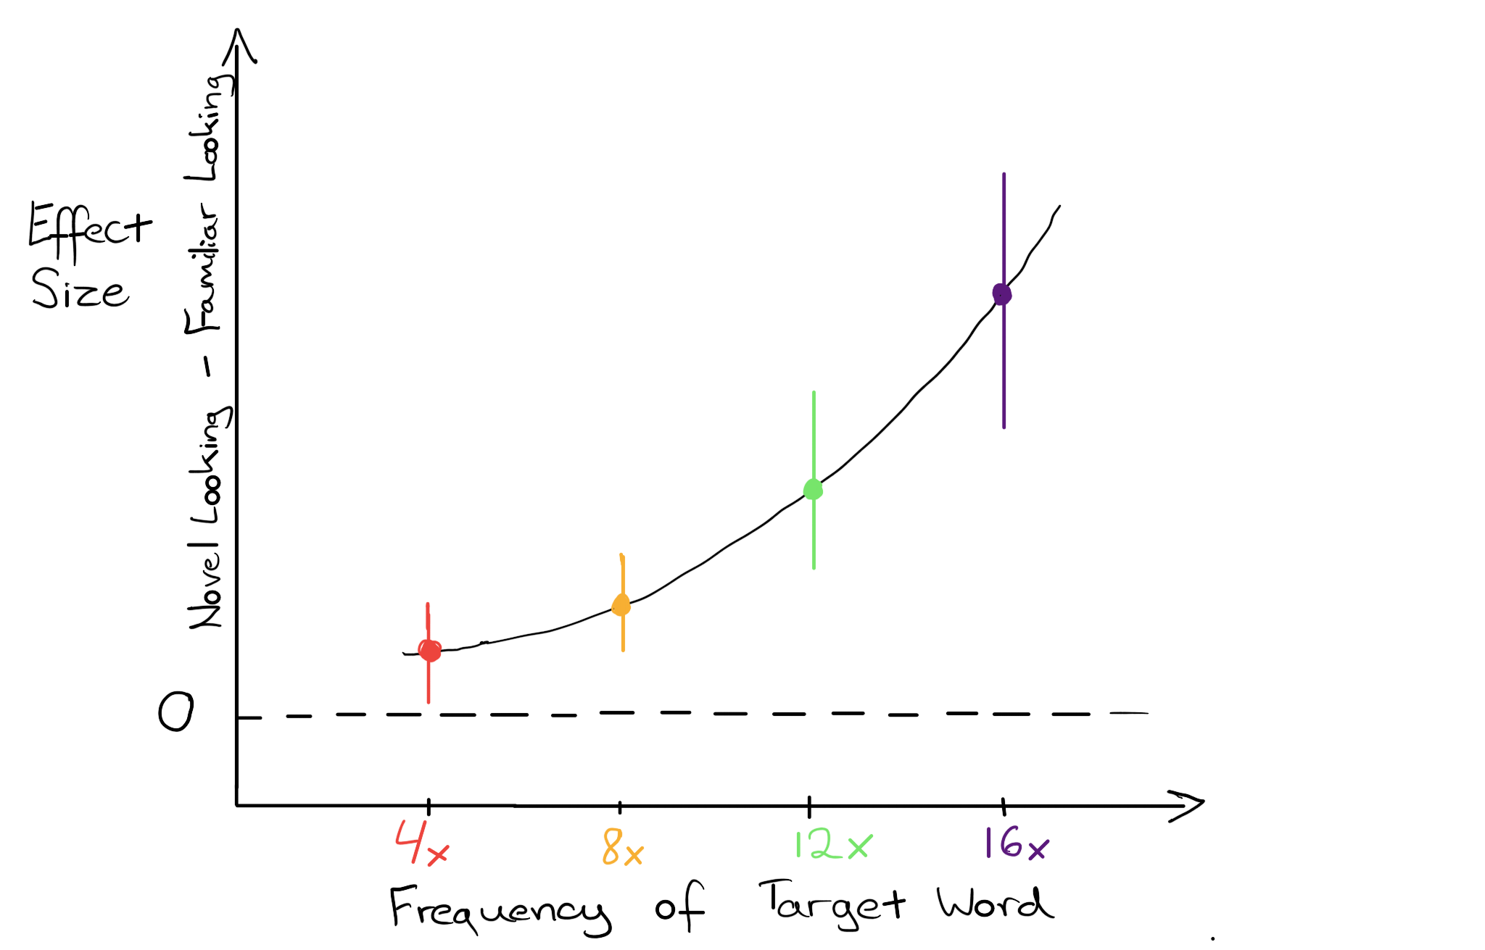
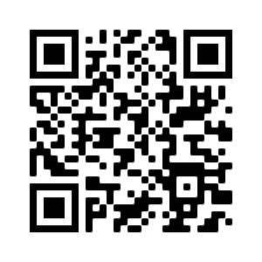

Investigating the relationship between infant learning and measured effect size in preferential looking paradigms
Martin Zettersten¹, Alexis K. Black², Christina Bergmann³, Desia Bacon¹, Haley Weaver¹, & Jenny Saffran¹
¹Department of Psychology, University of Wisconsin-Madison
²School of Audiology & Speech Sciences, The University of British Columbia
³Language Development Program, Max Planck Institute for Psycholinguistics
NSF-GRFP
DGE-1747503
to M.Z.,D.B.
NICHD R37HD037466 to J.S. and U54 HD090256
to the Waisman Center
2020 ICIS
7-7-2020
INTERPRETING LOOKING TIMES
DESIGN
PRELIMINARY RESULTS
How should we interpret the magnitude of looking time differences in infant learning studies?
Quantitative differences in looking time are assumed to be meaningful in most analytic approaches, but how these measures map onto learning is unclear.
These questions are especially relevant for
Choosing the best statistical analysis approach
using participant-level looking time differences as an individual difference measure
interpreting meta-analyses
Initial experiment to test the feasibility of training paradigm
No evidence of learning in either condition or evidence of differences between conditions.
4 Occurrences: t(26) = 0.95, p = .35, BF₀₁ = 3.27
16 Occurrences: t(23) = 0.41, p = .69, BF₀₁ = 4.32
No condition effect, t(49) = -0.42, p = .67, BF₀₁ = 3.31
Participants: 51 6-9-month-olds (M = 7.4 months; 26 F)
Pre-registered: n = 64, 32 per condition
https://osf.io/j49gr
Training Phase
8 nonse words presented in citation form, 80 total tokens
Frequency of target words manipulated between groups
4 Occurrences Condition: target words occur 4 times
16 Occurrences Condition: target words occur 16 times
EXPERIMENTAL APPROACH
Test Phase (Head-Turn Preference Procedure)
2 familiar (target) words vs. 2 novel words, presented in citation form; 12 test trials across 3 blocks
Test whether frequency of exposure systematically affects effect size in a novel word recognition study
Training study testing infants’ recognition of familiar words (e.g., Jusczyk & Aslin, 1995) presented in citation form during training and test.
Frequency of novel word occurrence during training manipulated across groups (~ strength of learning)
Possible patterns of results:
NEXT STEPS
Effect size similar across frequency of target word
Effect size scales with frequency of target word exposure
Revisit paradigm
Ideal paradigm will yield strong effects and allow for parametric manipulation of factor known to influence learning.
Looking for collaborators
Large sample size will be key.
Link to stimuli and experimental materials:
https://github.com/mzettersten/effie
References
Jusczyk, P., & Aslin, R. (1995), Cog Psych

